Slide 1
Generating Hangul Sequences

Slide 2
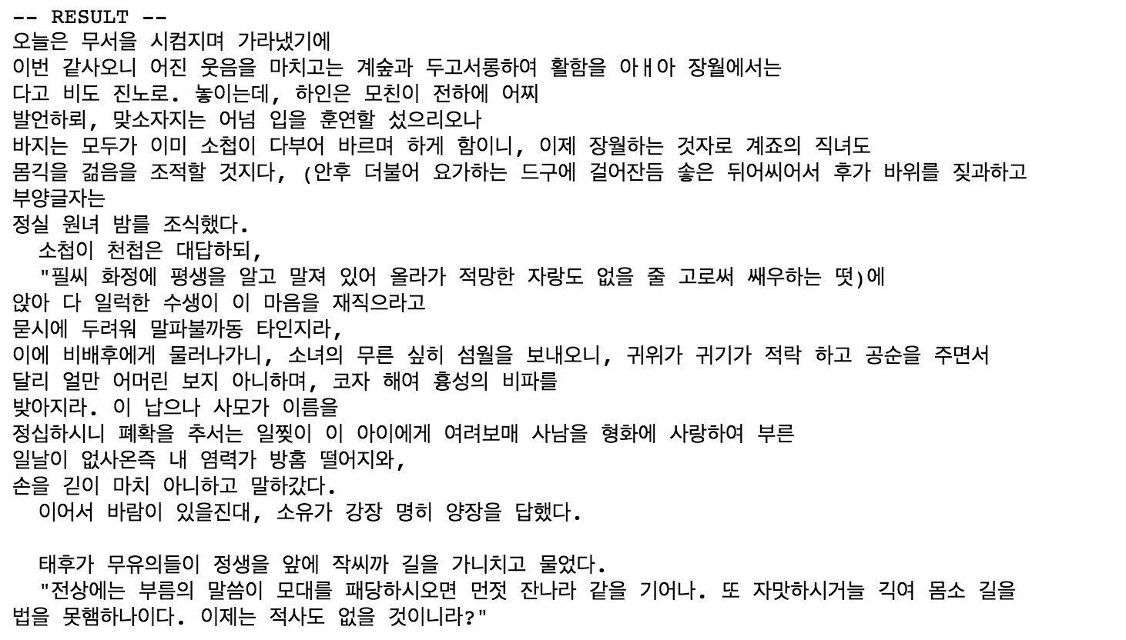
Goal

Slide 3
Preprocess txt with Hangul
demo_Hangul

Slide 4
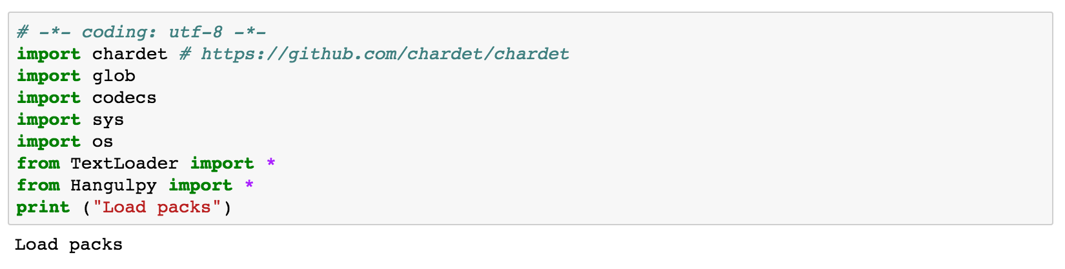
Load packages

Slide 5
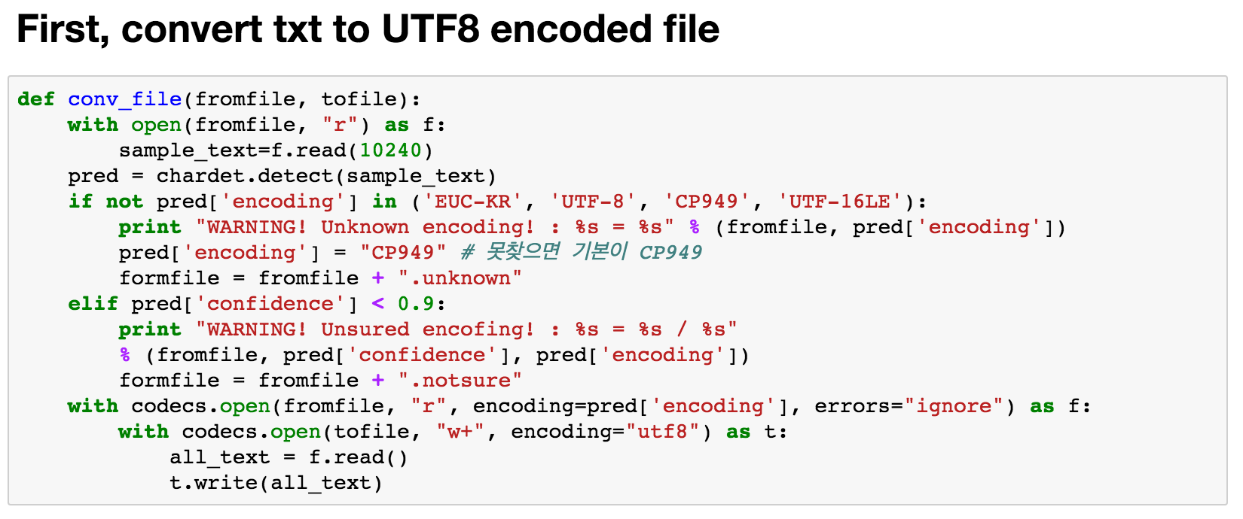
Converting function

Slide 6
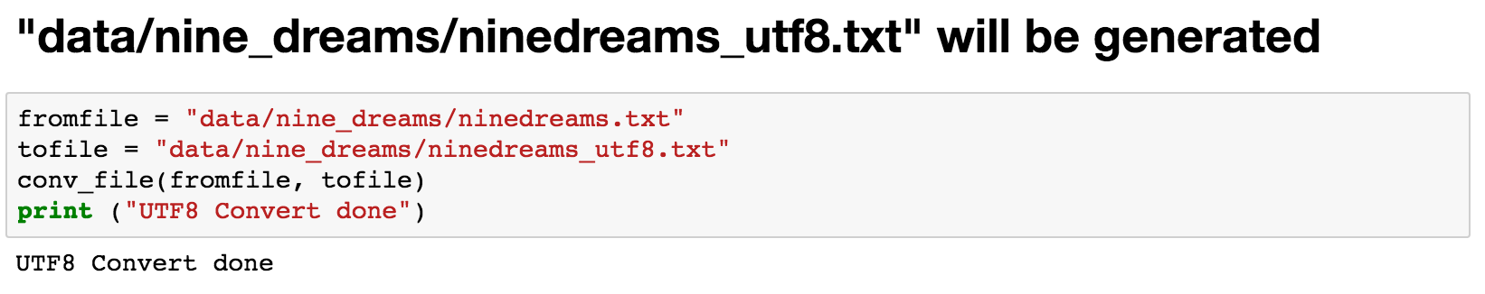
Convert

Slide 7
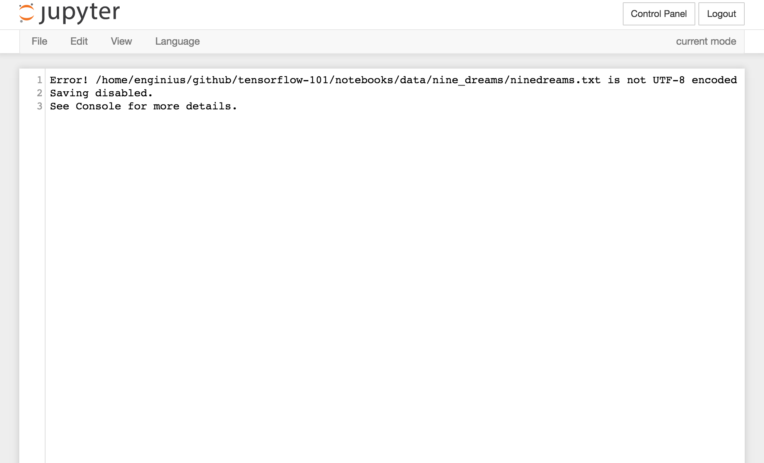
From this to..

Slide 8
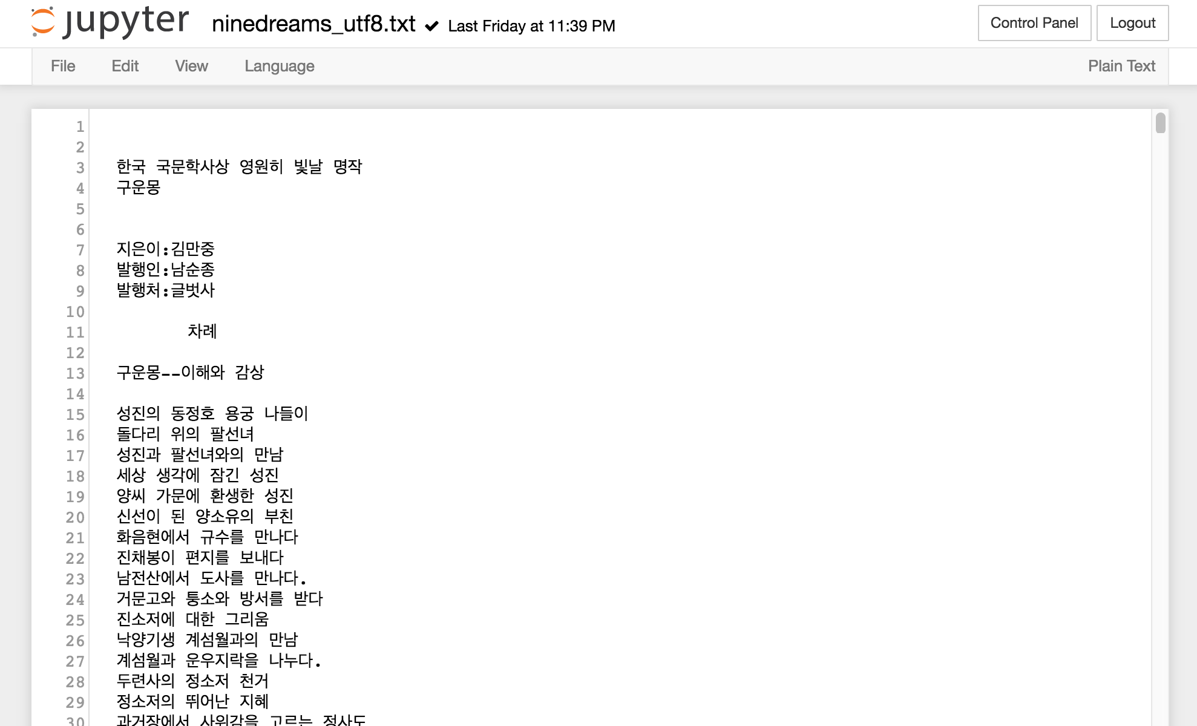
THIS!!

Slide 9
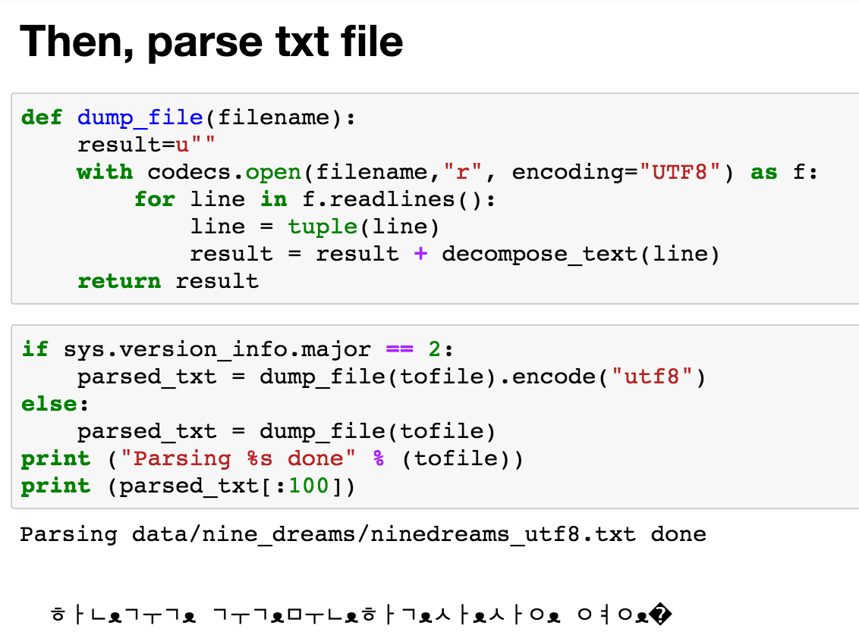
Parse Hangul

Slide 10
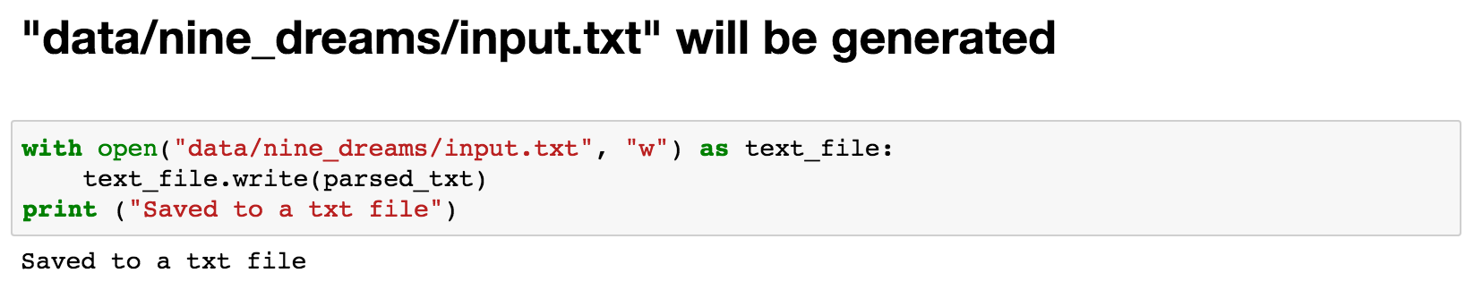
Save parsed Hangul

Slide 11
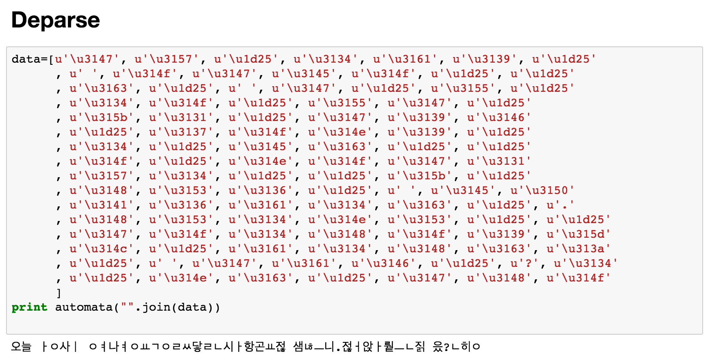
Deparse

Slide 12
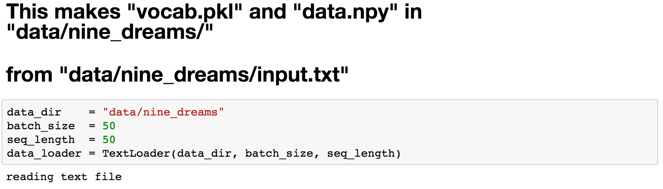
Dataloader
vocab: word->number
data: sequence of words

Slide 13
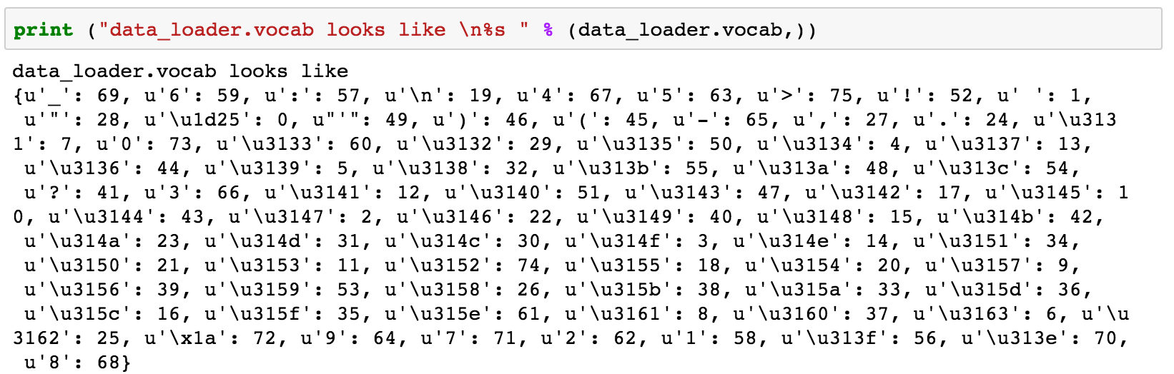
vocab: word->number

Slide 14
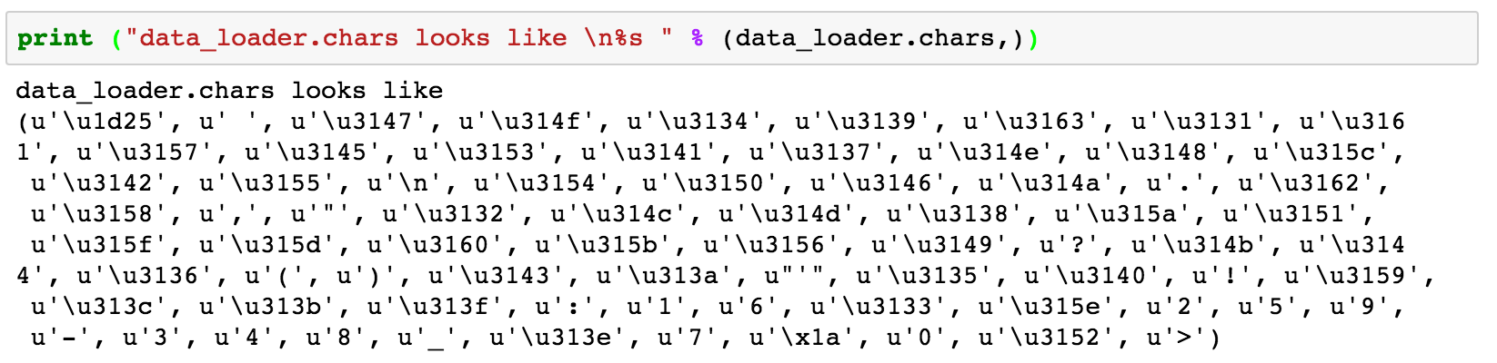
chars: sequence of chars

Slide 15
char_rnn_train_hangul

Slide 16
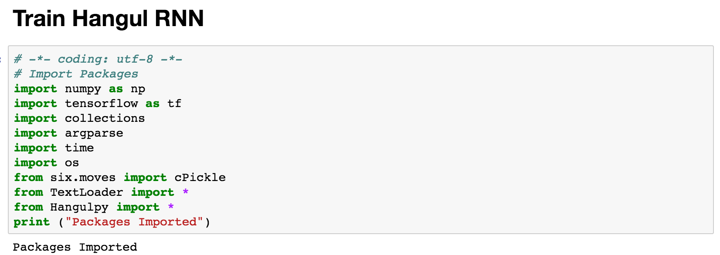
Packages

Slide 17
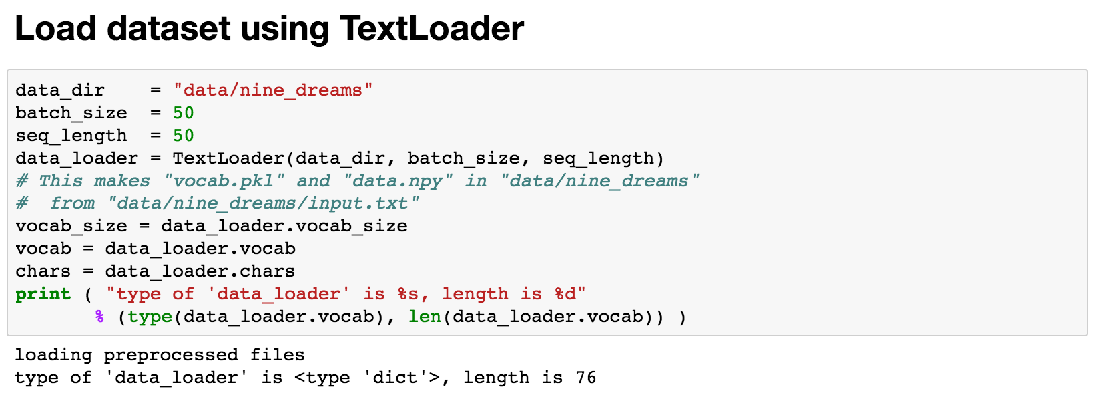
Load

Slide 18
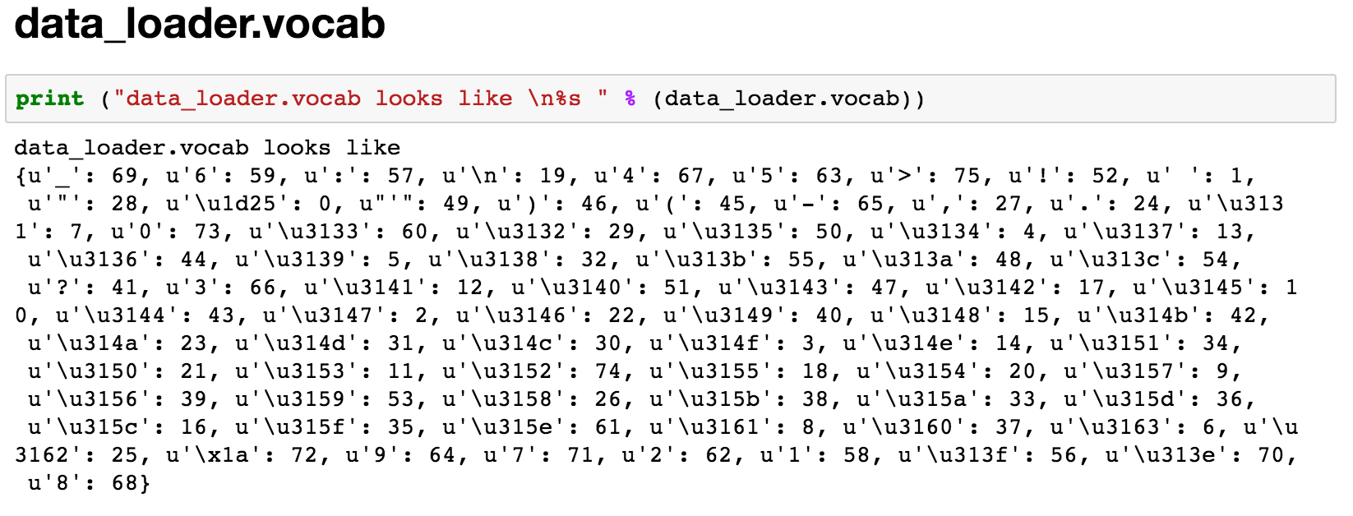
vocab

Slide 19
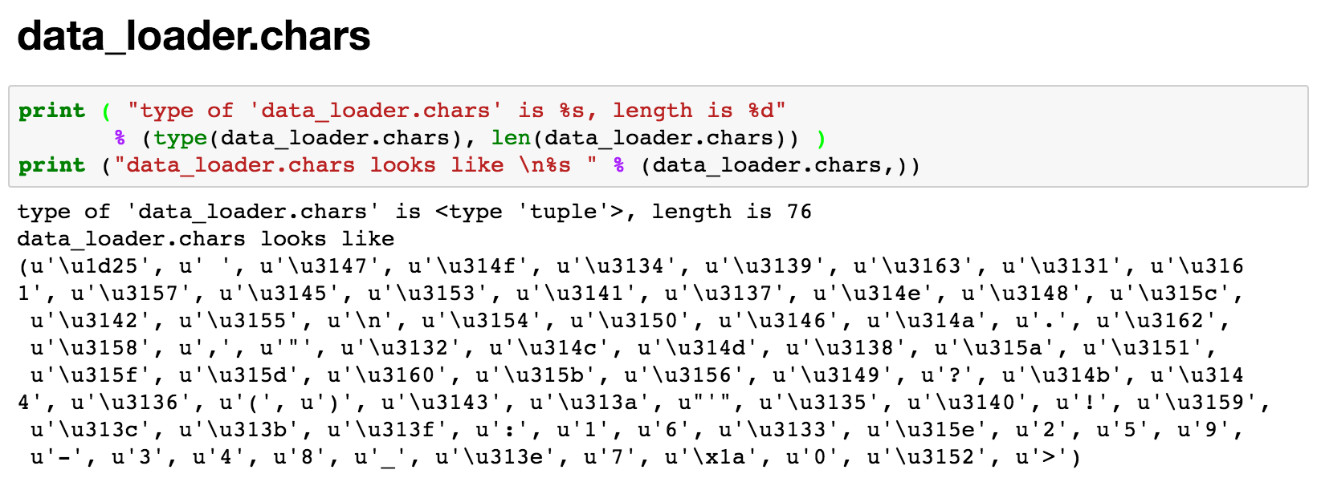
chars

Slide 20
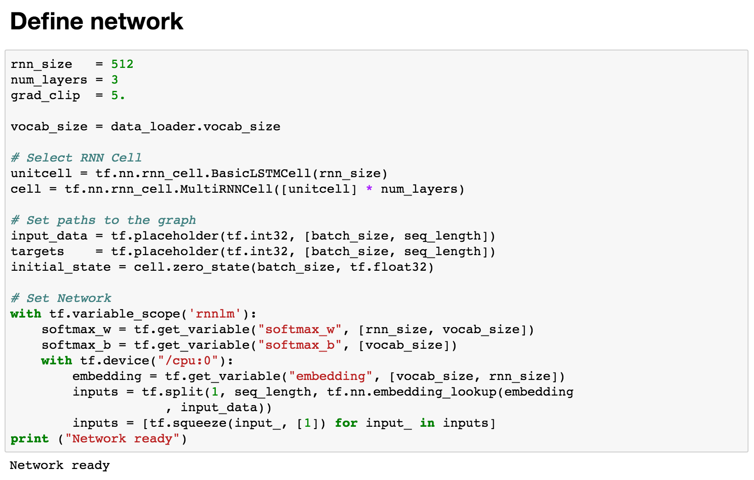
Define network for training
Use LSTM!
Multi-layer LSTMs!
Inputs and outputs
Automatically determine init states

Slide 21
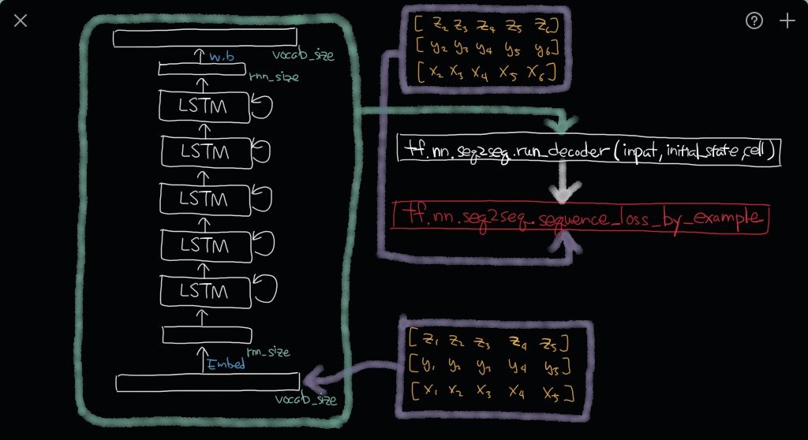
Define network for training

Slide 22
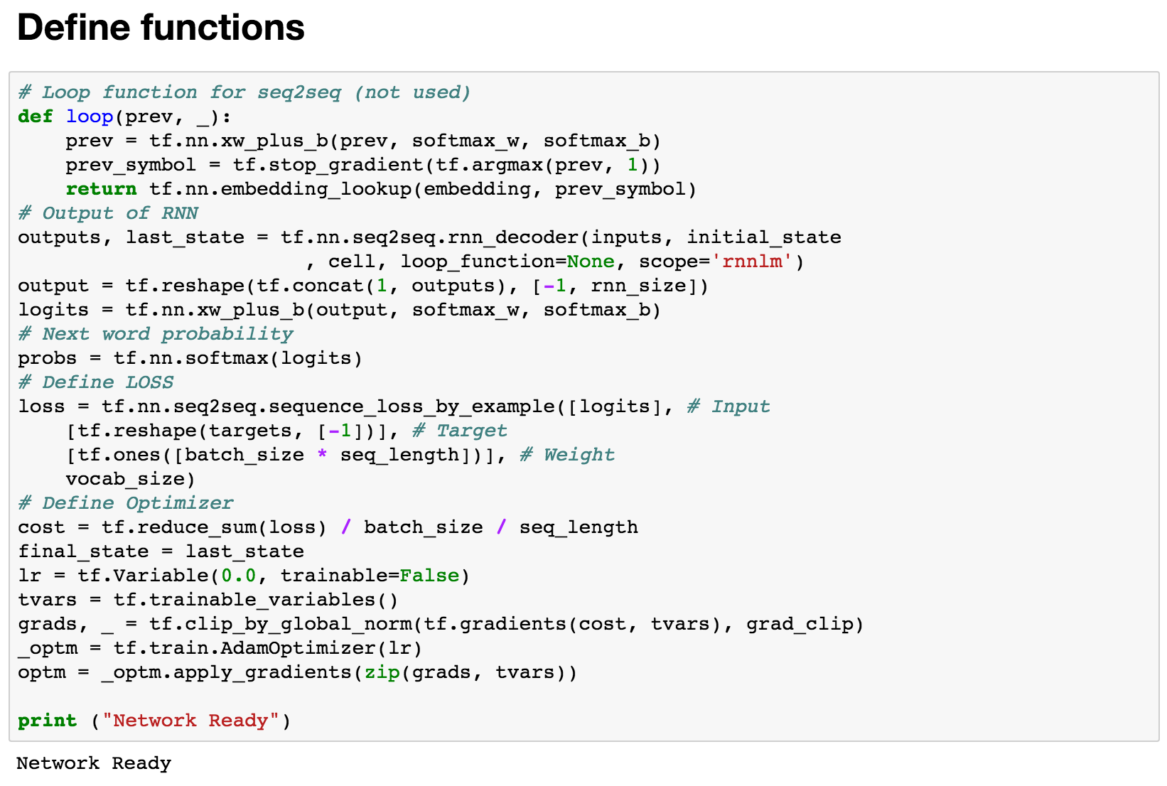
Define functions

Slide 23
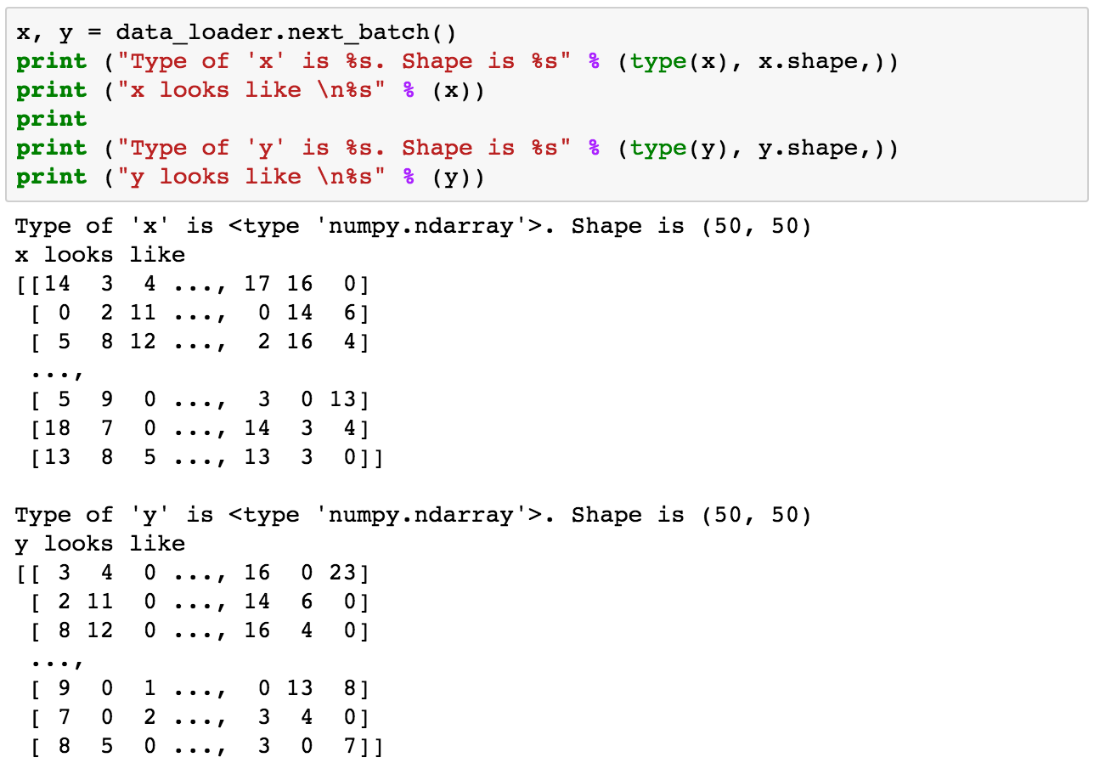
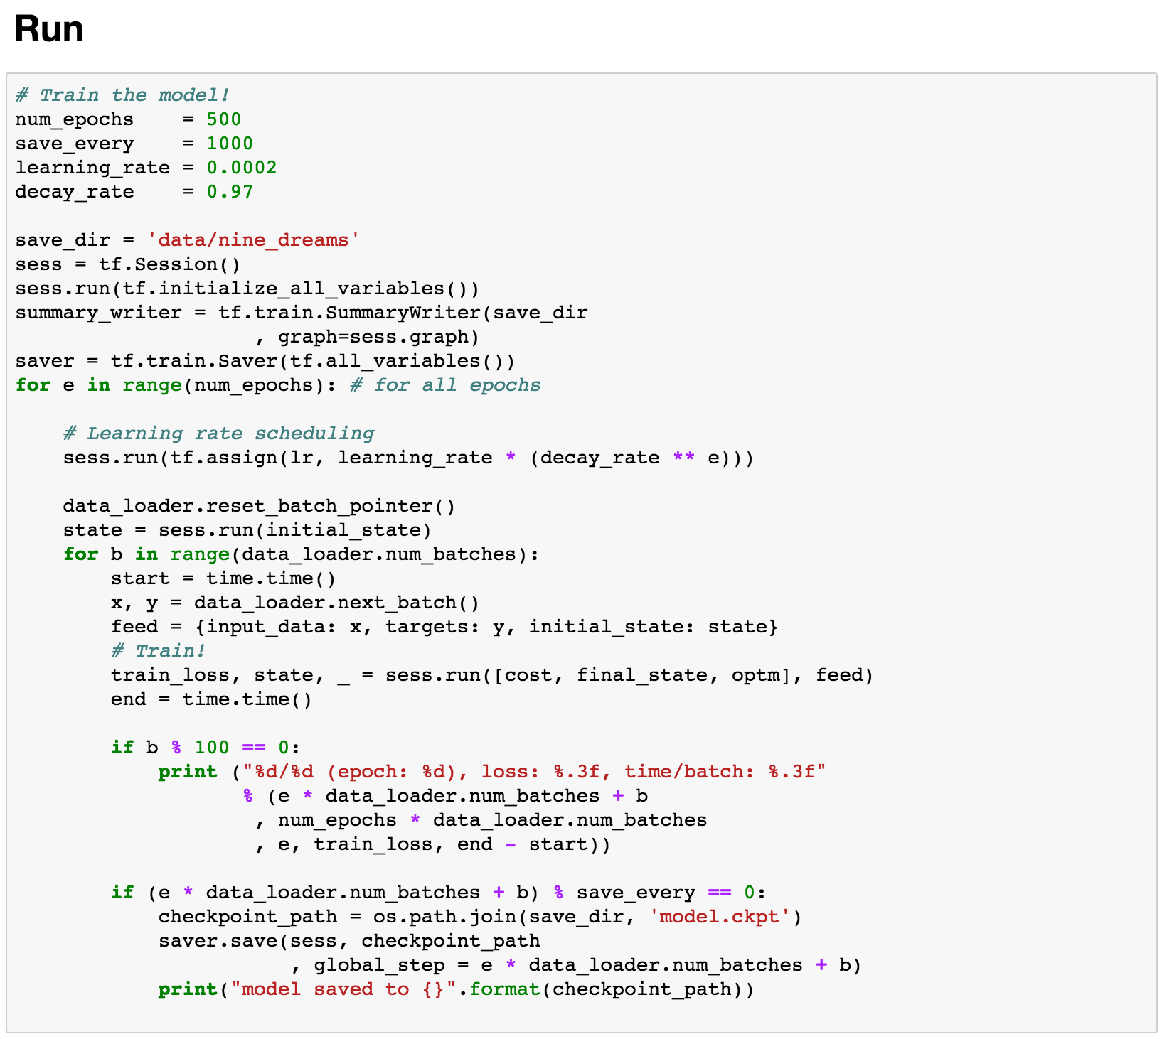
RUN!

Slide 24
char_rnn_sample_hangul

Slide 25
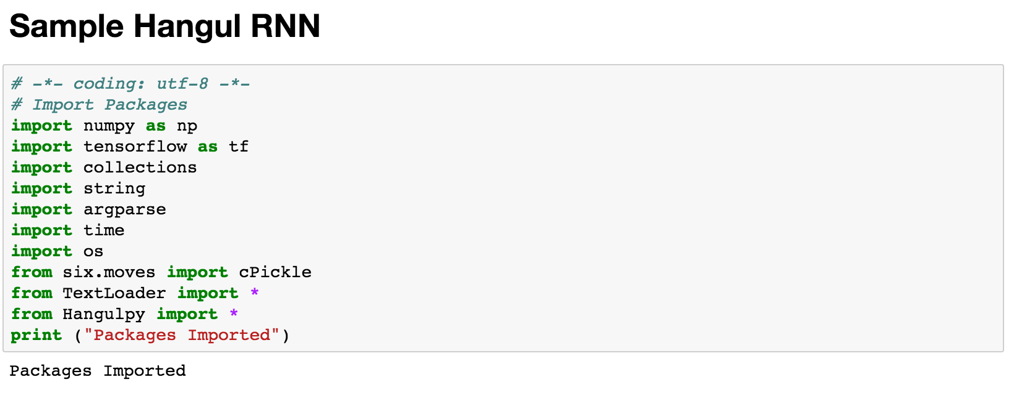
Packages

Slide 26
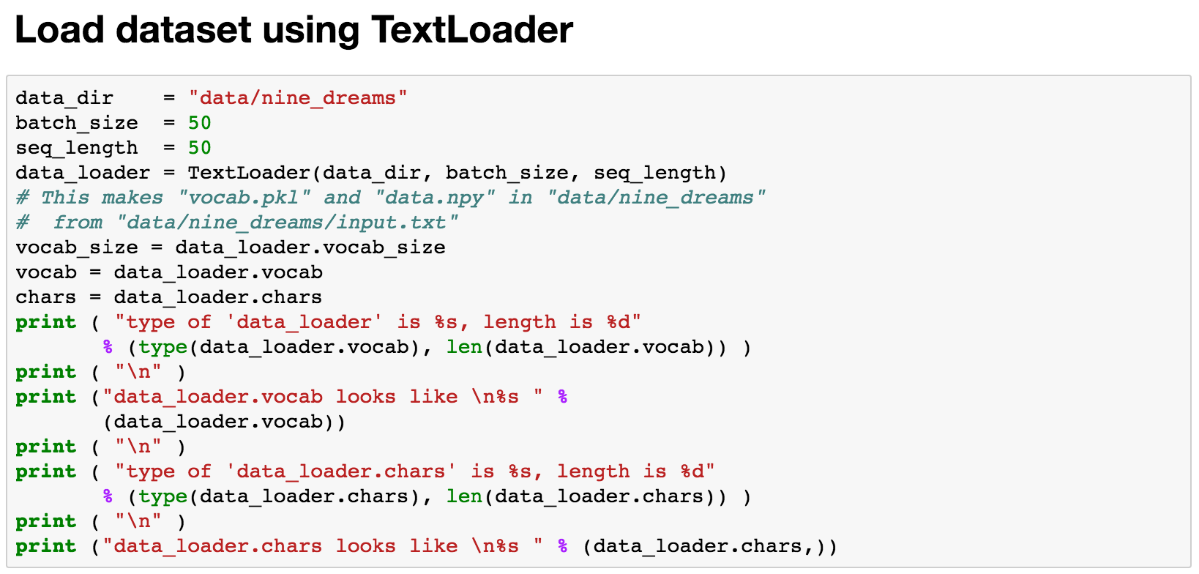
Load dataset

Slide 27
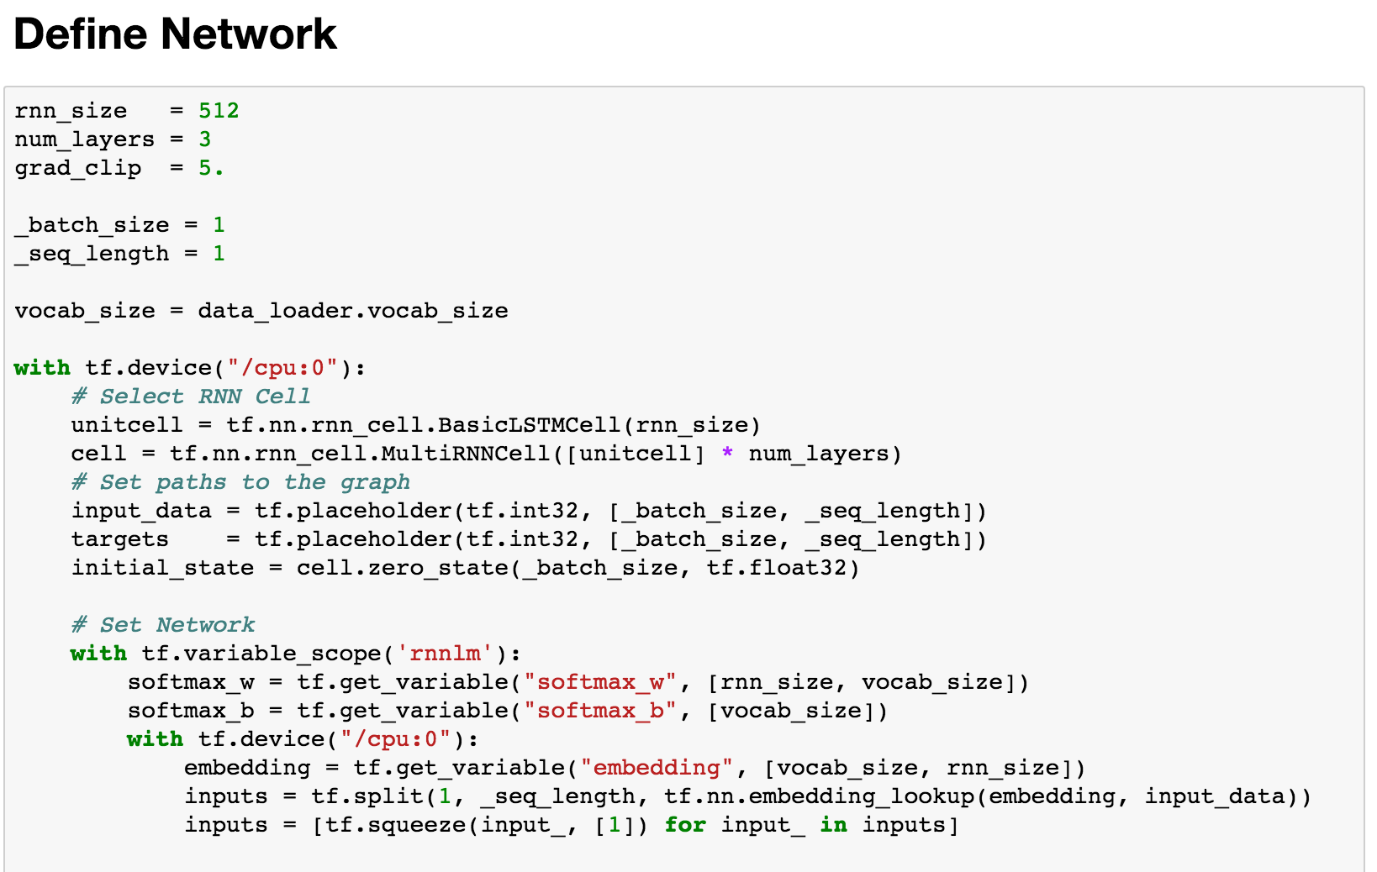
Define network for sampling
Network for training

Slide 28
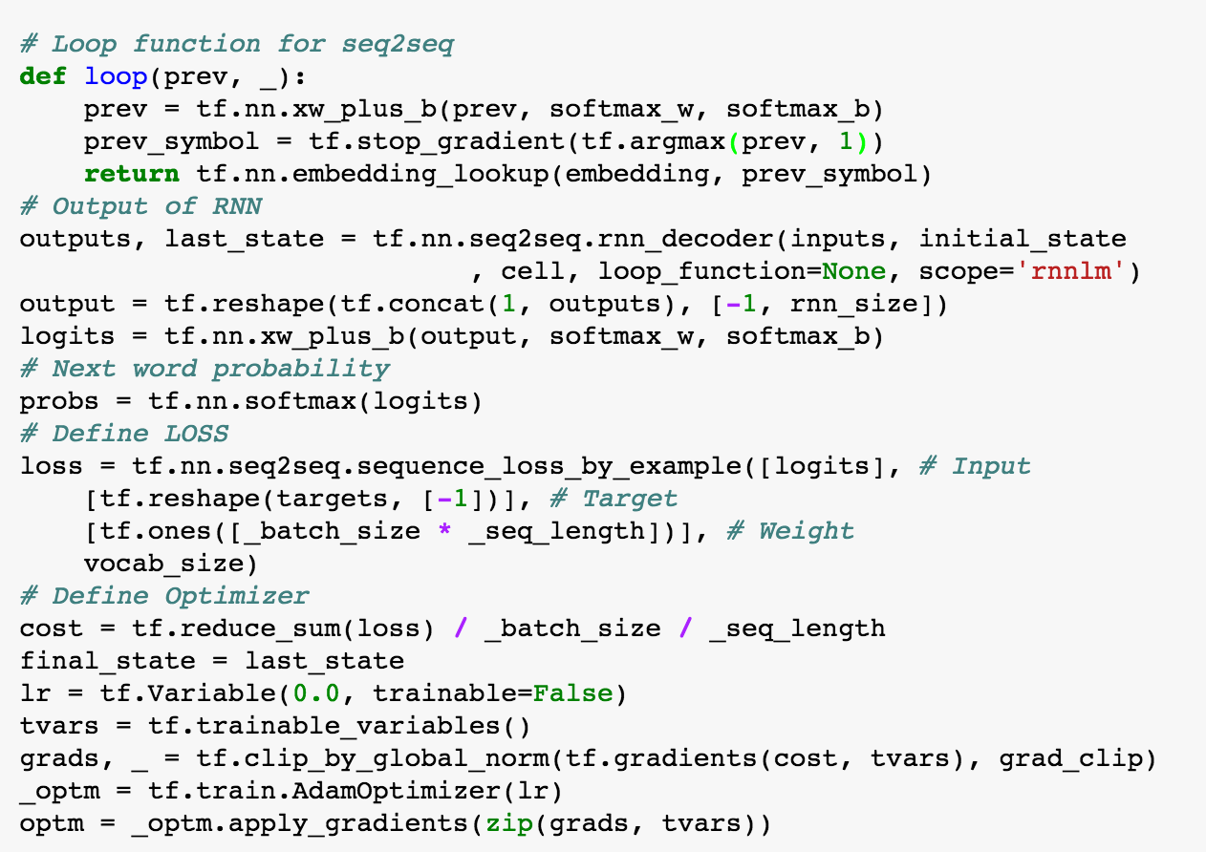
Define functions

Slide 29
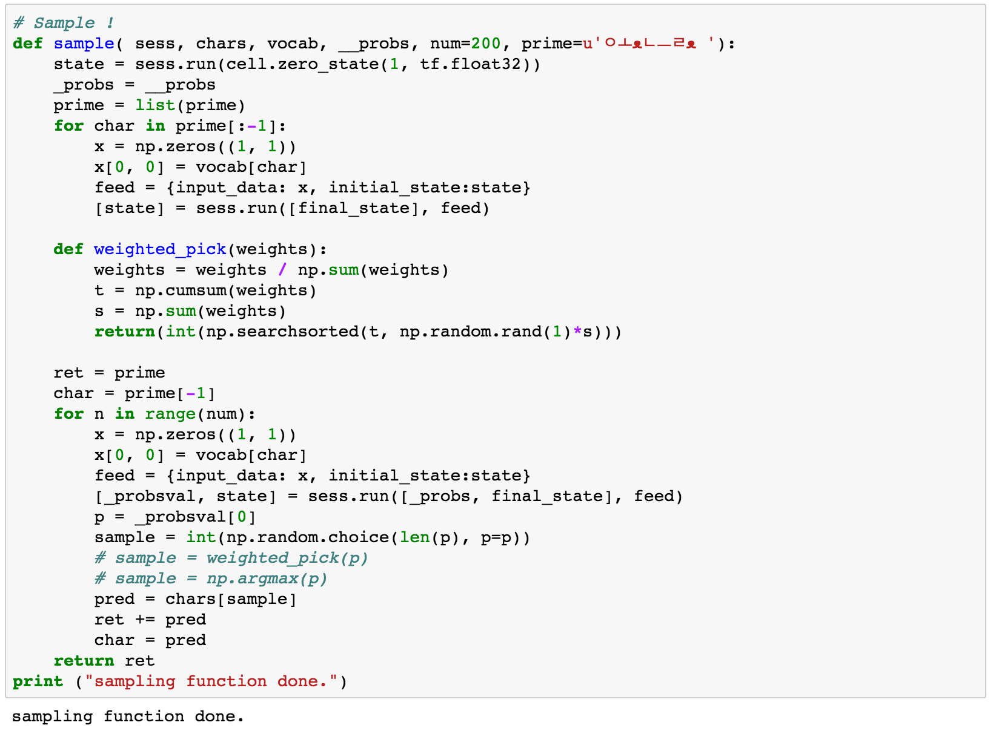
Sampling function

Slide 30
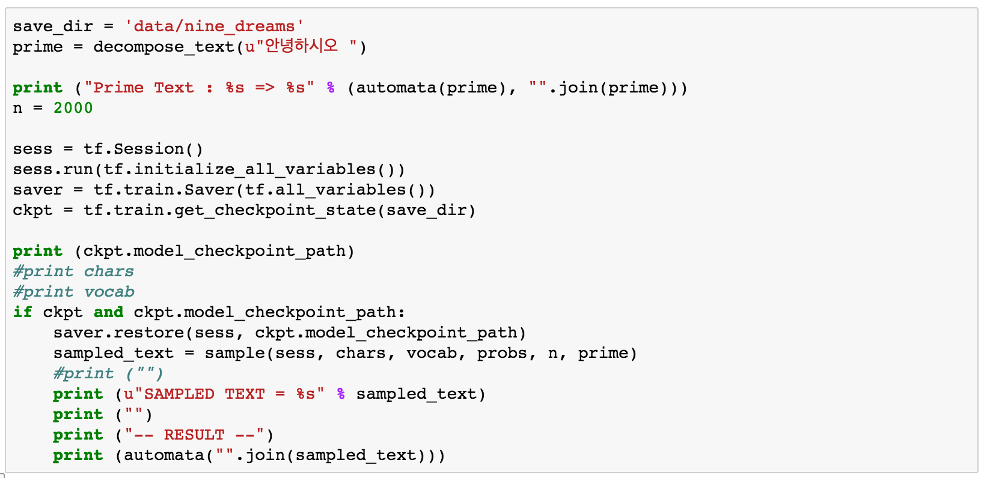
Sample!

Slide 31
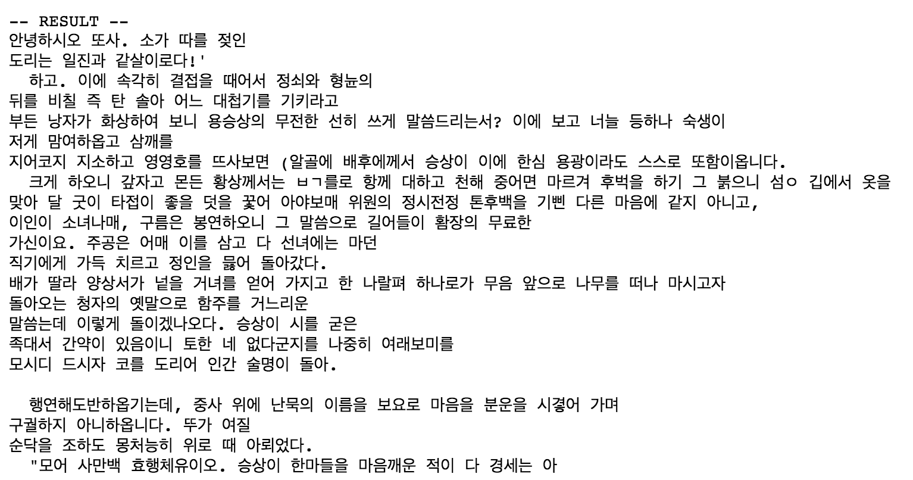
Result

Slide 32
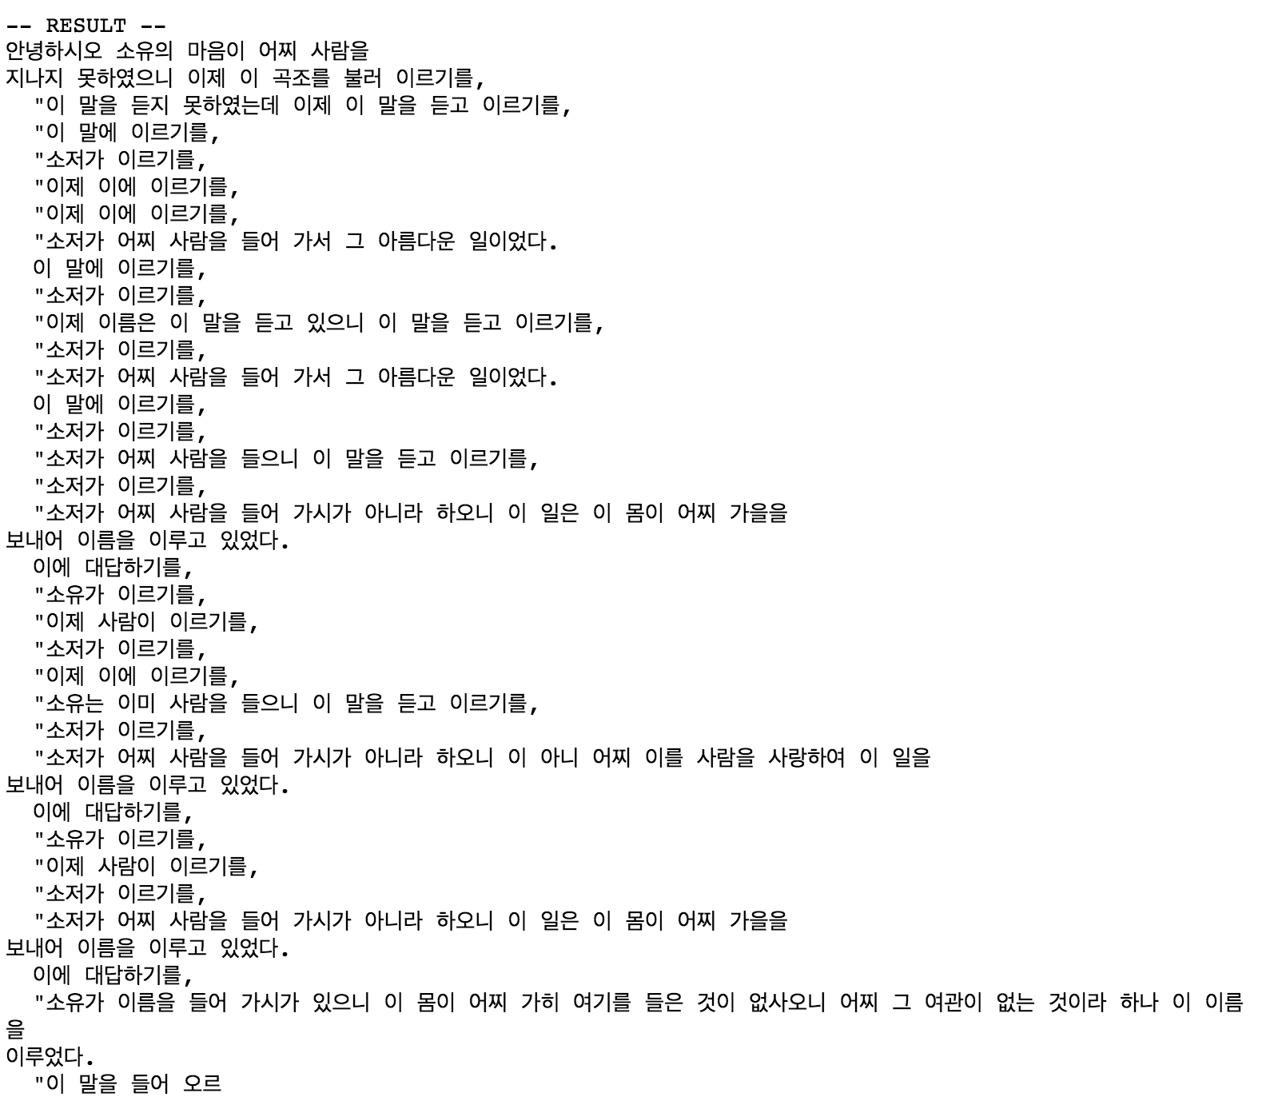
ArgMax sampling

